Slide 1
SEQ CPU Implementation

Slide 2
Outline
SEQ Stage Implementation
Suggested Reading 4.3.4

Slide 3
newPC
PC
New PC
data out
valM
read
Memory
Mem Control
Data memory
write
Addr
Data
Bch
valE
Execute
CC
ALU
ALU fun
ALUA
ALUB
valA
valB
dstE
dstM
srcA
srcB
Decode
dstE
dstM
srcA
srcB
A
B
M
Register file
E
Write Back
icode
ifun
rA
rB
valC
valP
Instruction Memory
PC increment
Fetch
PC

Slide 4
SEQ Hardware
Blue boxes: predesigned hardware blocks
  e.g., memories, ALU
Gray boxes: control logic
  Describe in HCL
White ovals: labels for signals
Thick lines: 32-bit word values
Thin lines: 4-8 bit values
Dotted lines: 1-bit values
Notes:
这个图中有些控制信号没有标出来。
似乎PC也应该是蓝色的。

Slide 5
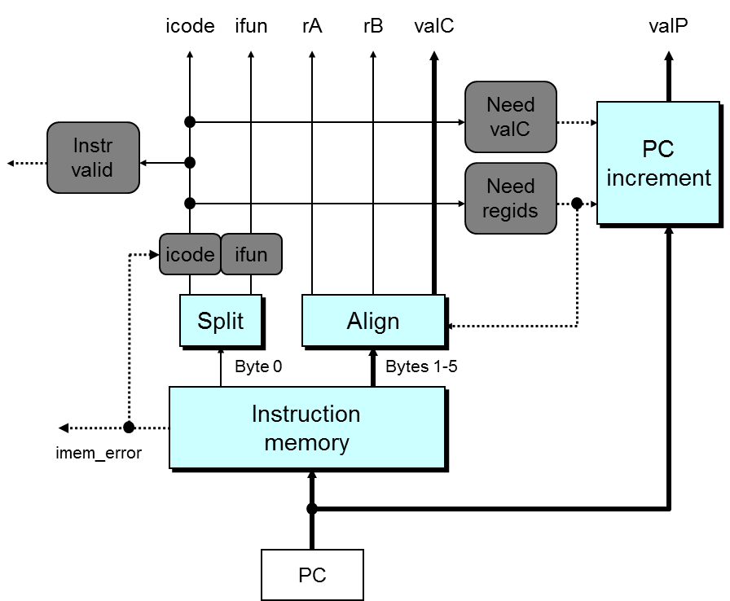
Fetch Logic
Notes:
事实上，不管需要几个字节，读入都是6个字节。
Split实际上是非常简单的。因为读出的一个字节就是8根信号线，只要将他们分为两股就可以了。
一个问题：Align没有使用Need valC信号，因为如果这条指令没有带常数，那么valC不管产生什么内容都无所谓。但valC到底是1-4字节还是2-5字节却要根据Need regids信号来确定。所以Need regids必须要，而Need valC可以不需要。
这也是一种常用的硬件设计方法：如果我们说一个信号在某种情况下用不到，那么它就可以是任意值。这样通过对它赋予某种赋值可以将他与其他信号合并或者其他简化。这里就是一个例子，valC并不是如果不需要的话，就为0。

Slide 6
Fetch Logic
Predefined Blocks
  PC: Register containing PC
  Instruction memory: Read 6 bytes (PC to PC+5)
  Split: Divide instruction byte into icode and ifun
  Align: Get fields for rA, rB, and valC

Slide 7
Fetch Logic
Control Blocks
  Instr. Valid: Is this instruction valid?
  Need regids: Does this instruction have a register bytes?
  Need valC: Does this instruction have a constant word?
  icode|ifun: Set to “nop” if imem_error

Slide 8
Some Macros
Name | Value | Meaning
INOP | 0 | Code for nop instruction
IHALT | 1 | Code for halt instruction
IRRMOVL | 2 | Code for rrmovl instruction
IIRMOVL | 3 | Code for irmovl instruction
IRMMOVL | 4 | Code for rmmovl instruction
IMRMOVL | 5 | Code for mrmovl instruction
IOPL | 6 | Code for integer op instructions
IJXX | 7 | Code for jump instructions
………… | …… | ……………………………
IPOPL | B | Code for popl instruction
Notes:
用在HCL中表示指令、寄存器、操作符类型

Slide 9
Some Macros
Name | Value | Meaning
RESP | 4 | Register ID for %esp
FNON | 0 | Default Function Code
RNONE | F | Indicates no register file access
ALUADD | 0 | Function for addition operation
SAOK | 1 | Status code for normal operations
SADR | 2 | Status code for address exception
SINS | 3 | Status code for illegal instruction Exception
SHLT | 4 | Status code for halt
Notes:
用在HCL中表示指令、寄存器、操作符类型

Slide 10
nop
0
0
0
nop
0
nop
0
0
0
0
halt
1
1
1
1
0
0
0
halt
0
halt
rA
rB
rA
rA
rB
rB
rA
rA
rB
rB
rA
rA
rB
2
rB
2
0
0
2
2
0
rrmovl
,
0
rrmovl
rrmovl
,
,
V
rB
V
V
rB
rB
rB
rB
V
rB
rB
V
3
V
3
0
0
8
3
8
3
0
0
8
irmovl
8
irmovl
irmovl
,
,
,
rA
D
rA
rB
rA
D
D
rB
rB
rA
rA
rB
rB
D
rA
rA
rB
rB
D
4
D
4
0
0
4
4
0
rmmovl
,
0
(
rmmovl
)
rmmovl
,
,
(
(
)
)
D
rB
rA
D
D
rB
rB
rA
rA
rA
rA
rB
rB
D
rA
rA
rB
rB
D
5
D
0
5
5
5
0
0
mrmovl
0
mrmovl
mrmovl
(
(
(
),
),
),
rA
rB
rA
rA
rB
rB
fn
fn
rA
rA
rB
fn
rB
fn
rA
rA
rB
6
rB
6
6
OPl
,
6
OPl
OPl
,
,
Dest
Dest
Dest
fn
fn
fn
fn
Dest
Dest
7
Dest
7
7
jXX
7
jXX
jXX
Dest
Dest
Dest
Dest
Dest
8
Dest
8
0
0
8
8
0
call
0
call
call
ret
ret
ret
9
9
9
9
0
0
0
0
rA
rA
rA
rA
rA
rA
A
rA
A
0
0
8
A
8
A
0
0
8
pushl
8
pushl
pushl
rA
rA
rA
rA
rA
rA
B
rA
B
B
B
0
0
0
0
8
8
8
popl
8
popl
popl
need_regids

Slide 11
Fetch Control Logic
bool need_regids = icode in
{ IRRMOVL, IIRMOVL, IRMMOVL, IMRMOVL, IOPL, IPUSHL, IPOPL };
bool instr_valid = icode in
{ INOP, IHALT, IRRMOVL, IIRMOVL, IRMMOVL, IMRMOVL, IOPL, IJXX, ICALL, IRET, IPUSHL, IPOPL };

Slide 12
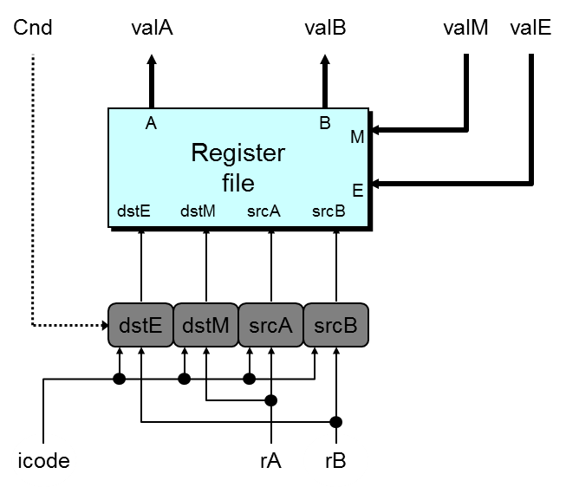
Decode & Write-Back Logic
Notes:
因为Decode阶段和Write Back阶段都主要是在操作register file，所以我们把他们合在一起讲。
写口E是用来写Execute阶段来的结果的，写口M是用来写Memory阶段来的结果的。
这里主要是要处理4个读写信号的地址。
当dstE和dstM相同时（这发生在popl %esp时），根据语义，应该是使用valM的值。

Slide 13
Decode &
Write Back Logic
Predefined Blocks
  Registers File
    Read ports A, B & Write ports E, M
    Addresses are register IDs or F (no access)

Slide 14
Decode &
Write Back Logic
Control Logic
  srcA: read port address for valA {rA, %esp}
  srcB: read port address for valB {rB, %esp}
  dstE: write port address for valE {rB, %esp}
  dstM: write port address for valM {rA}
  Cnd: used to decide whether set valE (cmovXX)

Slide 15
A Source
opl rA, rB
Decode
valA ← R[rA]
Read operand A
rmmovl rA, D(rB)
Decode
valA ← R[rA]
Read operand A
popl rA
Decode
valA ← R[%esp]
Read stack pointer
jXX Dest
Decode
No operand
call Dest
Decode
No operand
ret
Decode
valA ← R[%esp]
Read stack pointer
Notes:
具体的表见P283-284

Slide 16
A Source
int srcA = [
icode in { IRRMOVL, IRMMOVL, IOPL, IPUSHL } : rA;
icode in { IPOPL, IRET } : RESP;
1 : RNONE; # Don't need register
];
Notes:
具体的表见P283-284

Slide 17
E Destination
opl rA, rB
Write-back
R[rB] ← valE
Write back result
rmmovl rA, D(rB)
Write-back
None
popl rA
Write-back
R[%esp] ← valE
Update stack pointer
jXX Dest
Write-back
None
call Dest
Write-back
R[%esp] ← valE
Update stack pointer
ret
Write-back
R[%esp] ← valE
Update stack pointer

Slide 18
E Destination
int dstE = [
icode in { IRRMOVL, IIRMOVL,
IOPL} : rB;
icode in { IPUSHL, IPOPL, ICALL,
IRET }: RESP;
1 : RNONE; # Don't need register
];
// cmovXX is not considered

Slide 19
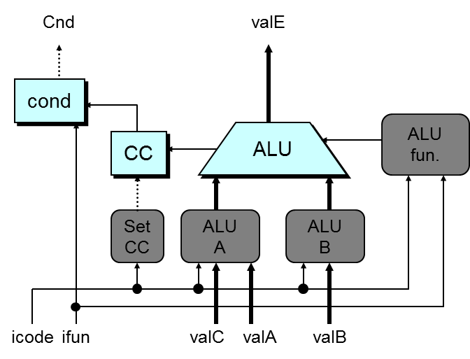
Execute Logic
Notes:
Set CC信号表示CC寄存器是否需要被更新。

Slide 20
Execute Logic
Predefined Blocks
  ALU: implements 4 required functions and
  generate condition code values
  CC: register with 3 condition code bits
  cond: computes condition flag

Slide 21
Execute Logic
Control Logical
  Set CC: Should condition code register be loaded?
  ALU A: Input A to ALU {valA, valC, +4, -4}
  ALU B: Input B to ALU {valB, 0}
  ALU fun: What function should ALU compute?

Slide 22
ALU A Input
OPl rA, rB
Execute
valE ← valB OP valA
Perform ALU operation
rmmovl rA, D(rB)
Execute
valE ← valB + valC
Compute effective address
popl rA
Execute
valE ← valB + 4
Increment stack pointer
jXX Dest
Execute
No operation
call Dest
Execute
valE ← valB + –4
Decrement stack pointer
ret
Execute
valE ← valB + 4
Increment stack pointer

Slide 23
ALU A Input
int aluA = [
icode in { IRRMOVL, IOPL } : valA;
icode in { IIRMOVL, IRMMOVL,IMRMOVL} : valC;
icode in { ICALL, IPUSHL } : -4;
icode in { IRET, IPOPL } : 4;
# Other instructions don't need ALU
];

Slide 24
ALU Operation
opl rA, rB
Execute
valE ← valB OP valA
Perform ALU operation
rmmovl rA, D(rB)
Execute
valE ← valB + valC
Compute effective address
popl rA
Execute
valE ← valB + 4
Increment stack pointer
jXX Dest
Execute
No operation
call Dest
Execute
valE ← valB + –4
Decrement stack pointer
ret
Execute
valE ← valB + 4
Increment stack pointer

Slide 25
ALU Operation / Condition Set
int alufun = [
icode == IOPL : ifun;
1 : ALUADD;
];
Bool set_cc = icode in { IOPL };

Slide 26
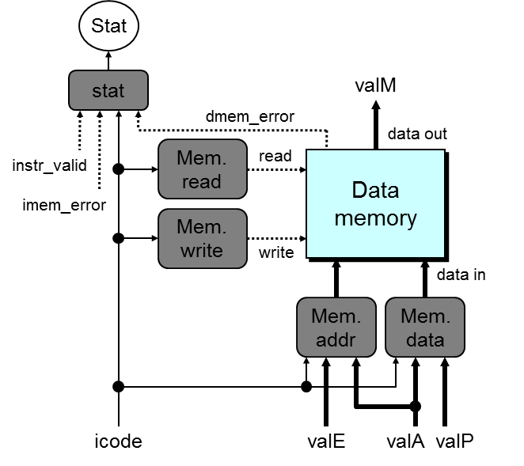
Memory Logic
Notes:
Mem read信号和Mem write信号不会同时为1。

Slide 27
Memory Logic
Predefined Blocks
  Memory: Reads or writes memory word

Slide 28
Memory Logic
Control Logical
  Mem. read: should word be read?
  Mem. write: should word be written?
  Mem. addr.: Select address {valA, valE}
  Mem. data.: Select data {valA, valP}

Slide 29
Memory Address
opl rA, rB
Memory
No operation
rmmovl rA, D(rB)
Memory
M₄[valE] ← valA
Write value to memory
popl rA
Memory
valM ← M₄[valA]
Read from stack
jXX Dest
Memory
No operation
call Dest
Memory
M₄[valE] ← valP
Write return value on stack
ret
Memory
valM ← M₄[valA]
Read return address

Slide 30
Memory Address
int mem_addr = [
icode in { IRMMOVL, IPUSHL, ICALL, IMRMOVL } : valE;
icode in { IPOPL, IRET } : valA;
# Other instructions don't need address
];

Slide 31
Memory Read
opl rA, rB
Memory
No operation
rmmovl rA, D(rB)
Memory
M₄[valE] ← valA
Write value to memory
popl rA
Memory
valM ← M₄[valA]
Read from stack
jXX Dest
Memory
No operation
call Dest
Memory
M₄[valE] ← valP
Write return value on stack
ret
Memory
valM ← M₄[valA]
Read return address

Slide 32
Memory Read/Write
bool mem_read = icode in { IMRMOVL, IPOPL, IRET };
bool mem_write = icode in { IRMMOVL, IPUSHL, ICALL };

Slide 33
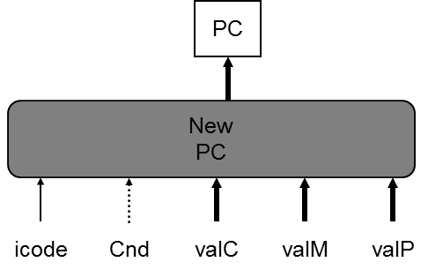
PC Update Logic
New PC
  Select next value of PC

Slide 34
PC Update
OPl rA, rB
PC update
PC ← valP
Update PC
rmmovl rA, D(rB)
PC update
PC ← valP
Update PC
popl rA
PC update
PC ← valP
Update PC
jXX Dest
PC update
PC ← Bch ? valC : valP
Update PC
call Dest
PC update
PC ← valC
Set PC to destination
ret
PC update
PC ← valM
Set PC to return address

Slide 35
PC Update
int new_pc = [
icode == ICALL : valC;
icode == IJXX && Cnd : valC;
icode == IRET : valM;
1 : valP;
];

Slide 36
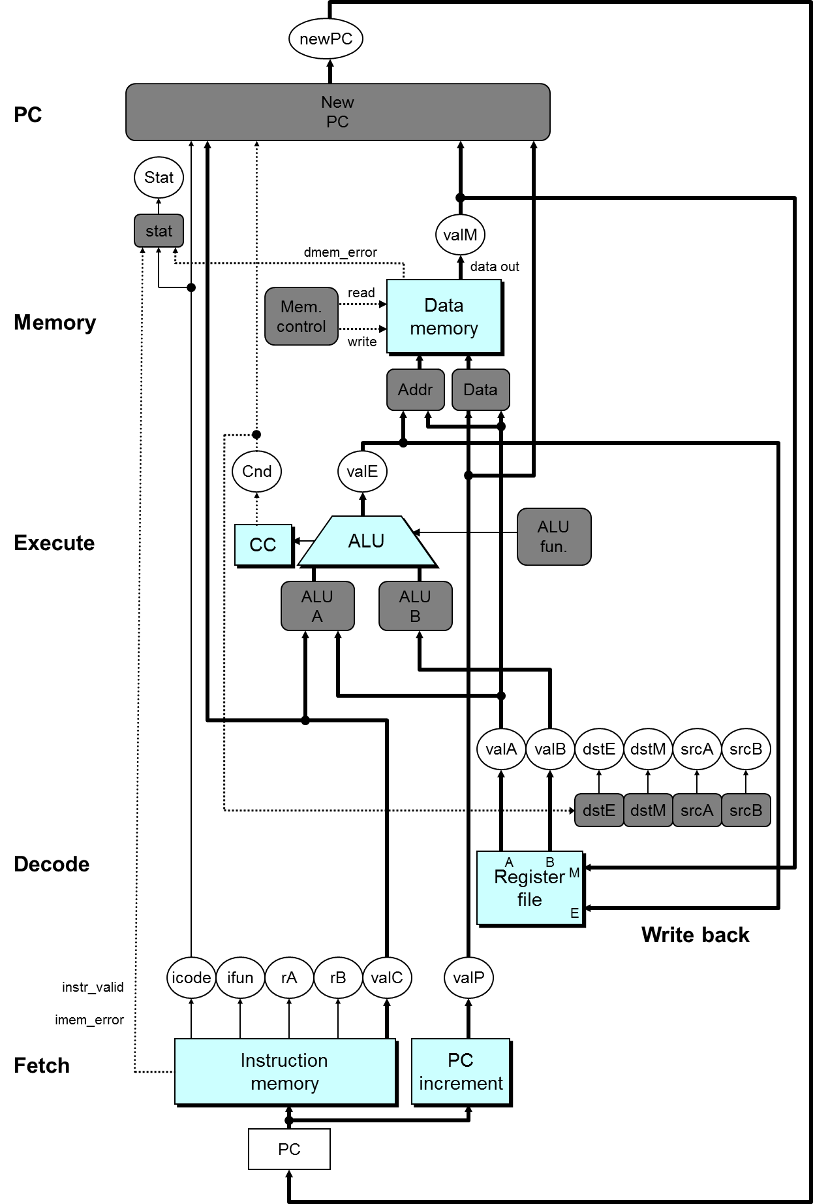

Slide 37
SEQ Summary
Implementation
  Express every instruction as series of simple steps
  Follow same general flow for each instruction type
  Assemble registers, memories, predesigned combinational blocks
  Connect with control logic

Slide 38
Limitations of SEQ
Too slow to be practical
  Too many tasks needed to finish in one clock cycle
    instruction memory, register file, ALU, and data memory
  Signals need long time to propagate through all of the stages
  The clock must run slowly enough
Does not make good use of hardware units
  Every unit is active for part of the total clock cycle

Slide 39
Principles of Pipeline

Slide 40
Outline
General Principles of Pipelining
  Goal
  Difficulties
Suggested Reading 4.4

Slide 41


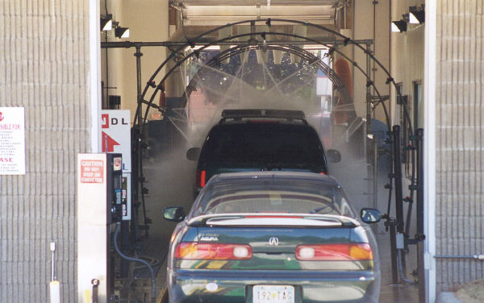
Real-World Pipelines: Car Washes
Sequential
Parallel
Idea
  Divide process into independent stages
  Move objects through stages in sequence
  At any given times, multiple objects being processed
Pipelined

Slide 42
Computational Example
300 ps
20 ps
Combinational
logic
R
e
g
Delay = 320 ps
Throughput = 3.12 GOPS
Clock
System
  Computation requires total of 300 picoseconds
  Additional 20 picoseconds to save result in register
  Can must have clock cycle of at least 320 ps
Notes:
Clock Cycle是320ps

Slide 43
3-Way Pipelined Version
100 ps
20 ps
100 ps
20 ps
100 ps
20 ps
Comb.
logic
A
R
e
g
Comb.
logic
B
R
e
g
Comb.
logic
C
R
e
g
Delay = 360 ps
Throughput =
8.33 GOPS
Clock
System
  Divide combinational logic into 3 blocks of 100 ps each
  Can begin new operation as soon as previous one passes through stage A.
    Begin new operation every 120 ps
  Overall latency increases
    360 ps from start to finish
Notes:
Clock Cycle是120ps。
之所以要增加阶段寄存器是因为B要用A的结果，原来B和A执行的是同一条指令，所以内容都是属于同一条指令的。
现在B和A在一个clock cycle里执行的是两条指令的内容，而B所需要的A的内容是上个周期中A产生的。所以必须保留下来给B用。所以要增加阶段间的寄存器。用以存放中间结果。

Slide 44
Pipeline Diagrams
Unpipelined
  Cannot start new operation until previous one completes
3-Way Pipelined
  Up to 3 operations in process simultaneously
OP1
OP2
OP3
Time
OP1
A
B
C
OP2
A
B
C
OP3
A
B
C
Time
Notes:
这就是时空图。
OP表示一条指令。
原来Unpipelined时候一条指令执行完了，才能执行另外一条指令。现在几条指令可以overlap。

Slide 45
Limitations: Nonuniform Delays
50 ps
20 ps
150 ps
20 ps
100 ps
20 ps
Comb.
logic
A
R
e
g
Comb.
logic
B
R
e
g
Comb.
logic
C
R
e
g
Delay = 510 ps
Throughput
= 5.88 GOPS
Clock
OP1
A
B
C
OP2
A
B
C
OP3
A
B
C
Time
Notes:
Clock cycle是170ps

Slide 46
Limitations: Nonuniform Delays
Throughput limited by slowest stage
Other stages sit idle for much of the time
Challenging to partition system into balanced stages
Notes:
Clock cycle是170ps

Slide 47
Limitations: Register Overhead
50 ps
20 ps
50 ps
20 ps
50 ps
20 ps
50 ps
20 ps
50 ps
20 ps
50 ps
20 ps
Comb.
logic
R
e
g
Comb.
logic
R
e
g
Comb.
logic
R
e
g
Comb.
logic
R
e
g
Comb.
logic
R
e
g
Comb.
logic
R
e
g
Clock
Delay = 420 ps,
Throughput = 14.29 GOPS
Notes:
时钟周期70ps。

Slide 48
Limitations: Register Overhead
As try to deepen pipeline, overhead of loading registers becomes more significant
Percentage of clock cycle spent loading register:
  1-stage pipeline: 6.25%
  3-stage pipeline: 16.67%
  6-stage pipeline: 28.57%
High speeds of modern processor designs obtained through very deep pipelining
Notes:
时钟周期70ps。

Slide 49
Data Dependencies
Combinational
logic
R
e
g
Clock
OP1
OP2
OP3
Time
System
  Each operation depends on result from preceding one

Slide 50
Data Hazards
Comb.
logic
A
R
e
g
Comb.
logic
B
R
e
g
Comb.
logic
C
R
e
g
Clock
OP1
A
B
C
OP2
A
B
C
OP3
A
B
C
OP4
A
B
C
Time
Notes:
dependency存在是没有问题的。
但当这种问题解决不了的时候，她就变成了一种hazard。

Slide 51
Data Hazards
Result does not feed back around in time for next operation
Pipelining has changed behavior of system
1 irmovl $50, %eax
2 addl %eax , %ebx
3 mrmovl 100(%ebx),%edx
Notes:
dependency存在是没有问题的。
但当这种问题解决不了的时候，她就变成了一种hazard。

Slide 52
Naïve Pipelined Implementation

Slide 53
Outline
SEQ+ Implementations
Suggested Reading 4.5.1 ~ 4.5.4

Slide 54
SEQ Hardware vs. SEQ+ Hardware
SEQ Hardware
  Stages occur in sequence
  One operation in process at a time
SEQ+ Hardware
  Still sequential implementation
  Reorder PC stage to put at beginning

Slide 55
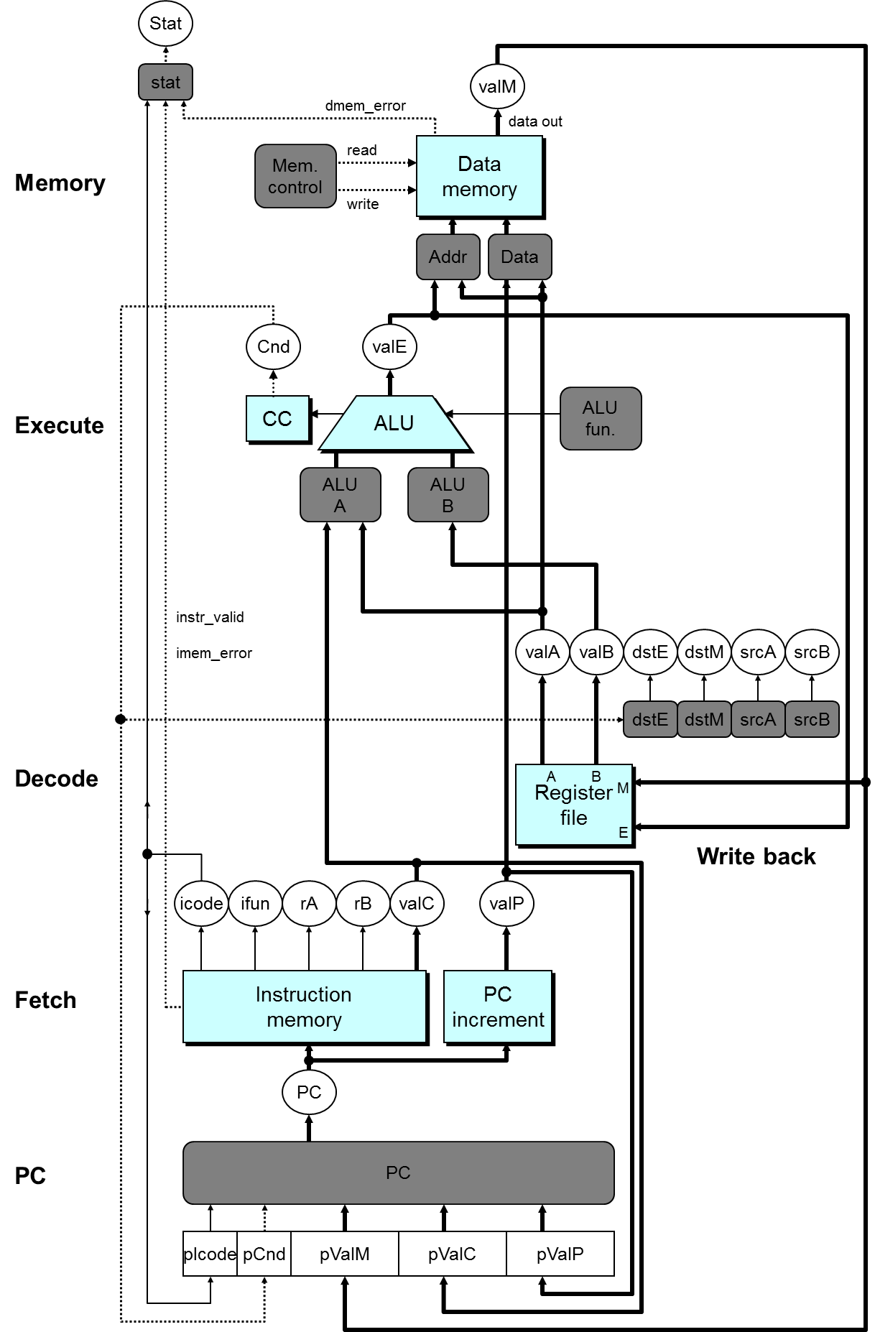

Slide 56
SEQ+ Hardware
PC Stage
  Task is to select PC for current instruction
  Based on results computed by previous instruction
Processor State
  PC is no longer stored in register
  But, can determine PC based on other stored information
Notes:
可能初看上去非常古怪。明明计算下条指令地址PC应该是在本指令快结束时才能进行的。为什么放到了指令的开始呢。
因为我们把计算下条指令地址变成了计算本条指令地址。也就是说算出来的PC(圆圈中的那个)不是下条指令的地址，而是本条指令的地址。
相当于对时序进行切分时向前移动了一点。
在这种情况下，虽然lSA说存在一个PC寄存器。但实际上并不存在这个寄存器。相反，存在其他几个寄存器pIcode, pBch, pValM, pValC, pValP。（但程序员不可见）
另外，这种变换也没有引起问题。例如相对跳转(PC-relative寻址)(虽然Y86不存在这种寻址方式)，这种寻址方式实际上是在Execute阶段将valP的值+偏移量。所以没有使用PC的值，即使用了在Fetch之前新的PC也已经有了，所以对于其后的各个阶段来说PC和SEQ中的是一样的。
这种变换的主要目的是要说明ISA和实现之间并不需要一一对应，只要语义一致就可以了。
这种变换也方便了我们下面要实现的PIPE。因为PIPE的地址预测是在fetch阶段就做的。

Slide 57
PC Computation
int pc= [
picode == ICALL : pValC;
picode == IJXX && pBch : pValC;
Picode == IRET : pValM;
1 : pValP;
];

